Slide 1

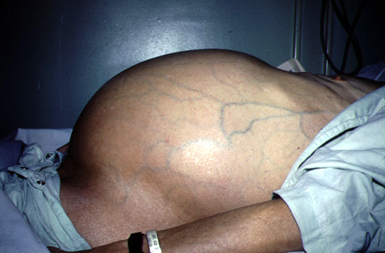
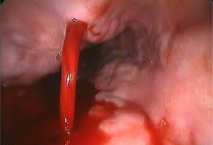
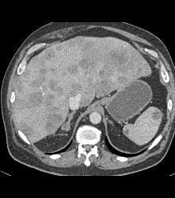
Management of Complications of Cirrhosis
Prof Madunil A Niriella
Professor in Gastroenterology, Faculty of Medicine, Ragama Honorary & Honorary Consultant Gastroenterologist, CNTH, Ragama

Slide 2
1. Variceal UGIB

Slide 3
What are the sources of UGI bleeding?

Slide 4
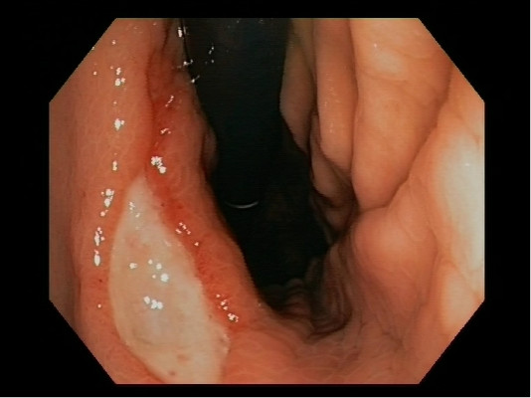
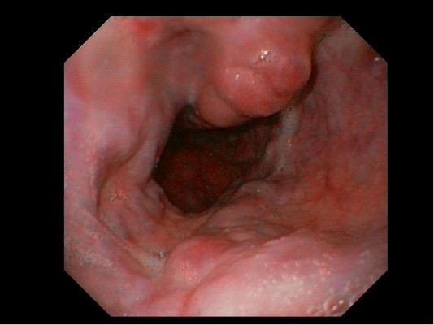
Sources of UGI bleeding
Non-portal hypertensive bleeds
Ulcer bleeding
Non-ulcer bleeding
Mallory-Weiss tears
Oesophagitis
Neoplasms
Dieulafoy lesions
Portal hypertensive bleeds
Oesophageal varices
Gastric fundal varices
Portal hypertensive gastropathy
(PHG)

Slide 5
Initial assessment
Haemodynamic status should be assessed immediately upon presentation
Resuscitative measures begun as needed
Blood transfusions should target Hb ≥7 g/dL
Higher Hb ≥ 8 g/dL only targeted in
patients with clinical evidence of intravascular volume depletion
patients with co-morbidities, such as coronary artery disease
Laine, Jensen AJG 2012;170:345

Slide 6
Patients with liver disease
Outcome is closely related to the severity of underlying liver disease - CTP Class (A, B, C)
Overall mortality of the first bleeding episode is 30-50%
less than 10% in CTP Class A patients
Greater than 50% in CTP Class C patients
Other factors
Size of varices (large vs. small)
Presence of red marks on the varices

Slide 7
Medical therapy before endoscopy?

Slide 8
Pre-endoscopic medical therapy
Consider IV Erythromycin
Improve visibility
May increase diagnosis at 1st UGIE
Reduce 2nd look UGIE
Consider IV PPI
Fewer high-risk stigmata, endoscopic therapies
No change in any clinical outcome
If endoscopic therapy not available or cannot be performed, less ulcer re-bleeding
Gastro 2002;123:17; AJG 2006;101:1211; GIE 2002;56:174; NEJM 2007;356:1631; Mayo Clin Proc 2007;82:286;

Slide 9
Pre-endoscopic medical therapy
Vasoactive drugs in cirrhotics
IV terlipressin, IV octreotide
Less active bleeding at UGIE; better 12-hr bleeding control
Antibiotics in cirrhotics
PO norfloxacin or IV ceftriaxone
Significantly reduces infection, re-bleeding, and mortality
Lancet 1995;346:865; Lancet 1997;350:1495; Cochrane 2010 Issue 9. Art. No.: CD002907

Slide 10
Pre-endoscopic medical therapy
Gastric lavage
Nasogastric or orogastric lavage is not required in patients with UGIB for
Diagnosis
Prognosis
Visualization
Therapeutic effect
Laine, Jensen AJG 2012;170:345

Slide 11
When to perform endoscopy?

Slide 12
Early endoscopy
All patients hospitalized with UGIB
UGIE ≤ 24 hrs: ↓ length of stay, surgery (Observational)
Low-risk patients (normal VS, no serious co-morbidity)
UGIE ≤ 2-6 hrs can lower cost by allowing early discharge (~40-45%) (RCTs)
High-risk patients (↓BP, ↑HR, cirrhosis)
UGIE within 12 hours
RCT subgroup analysis: reduce transfusions, hospital stay
Observational study: ↓ mortality
More high-risk lesions if UGIE ≤ 8 hrs
Cooper et a l. Med Care 1998;36:462 ; G IE 1 9 9 9 :49:145; Lee et al. GIE 1999;50:755; Bjorkman et al. GIE 2004;60:1;
Lin et al. JCG 1996;22:267; Lim et al. Endoscopy 2011; 43:300; Tsoi et al. Nat Rev Gastr Hep 2009;6:463

Slide 13
How to manage variceal bleeding?

Slide 14
Transfusion in cirrhotics with UGIB
Don’t transfuse FFP for elevated PT
Decreased pro- and anticoagulants in cirrhosis
PT measures pro-coagulant activity
Transfusion of PRBC aimed at Hb of 7-8 g/dl
RCT showed better outcome vs. 9-10 g/dl target
Segal et al. Transfusion 2005;45:1413;Tripodi et al. APT 2007;26:14; Stanworth et al. Br J Haemato 2004;126:139;
Colomo et al. Hepatology 2008;48(Suppl):413A;403A

Slide 15
Management of acute variceal bleeding
Ligation + vasoactive drug for 2-5 days
Ligation more effective than sclerotherapy for haemostasis with active/acute bleeding
Combination ligation and vasoactive drug superior to vasoactive drug in rebleeding
Combination ligation and terlipressin/octreotide superior to ligation in further bleeding
Garcia-Tsao et al. Hepatology 2008;47:1764; de Franchis J Hepatol 2010;53:762; Lo et al. Hepatology 1997;25:110; Villaneuva et al. J Hepatol 2006;45:560; Lo, G-H et al. Gut 2009;58:1275-1280; Sung et al. Lancet 1995;346:1666

Slide 16
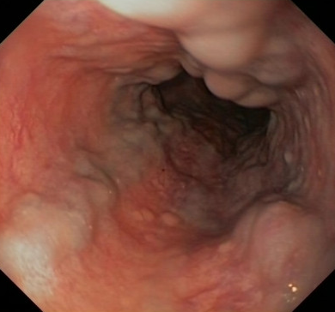
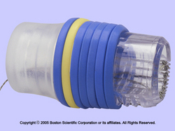
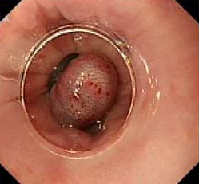
Variceal ligation

Slide 17
Early TIPS as primary therapy for acute variceal bleeding
2 RCTs of TIPS within 24-72 hrs
High-risk patients
HVPG ≥ 20 mm Hg
Childs C; Child B with active bleeding
Significant decrease in further bleeding and mortality
Monescillo et al. Hepatol 2004;40:793; Garcia-Pagan, et al. NEJM 2010;362:2370

Slide 18
Failure of therapy for acute variceal bleeding
Defined as persistent or recurrent bleeding in first 5 days after endoscopic and pharmacologic therapy
Repeat endoscopic therapy or TIPS
TIPS if persistent bleeding or severe further bleeding
Oesophageal stents: initial reports promising
deFranchis et al. J Hepatol 2010;53:762

Slide 19
Prevention of recurrent variceal bleeding

Slide 20
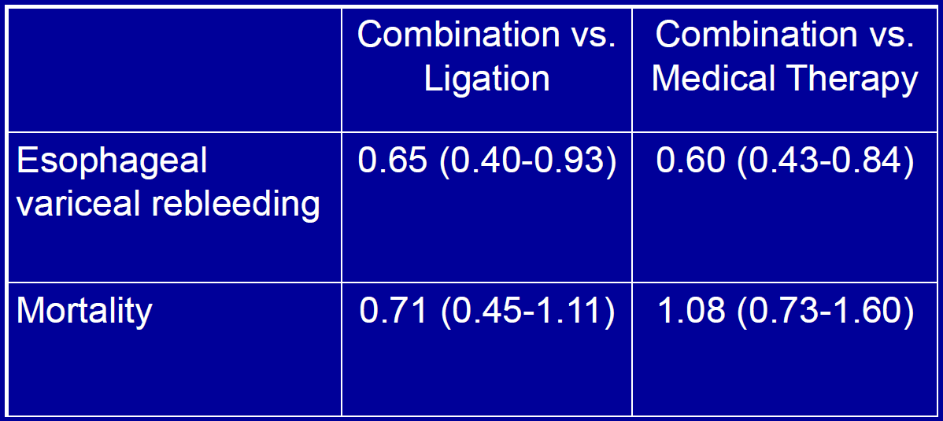
Ligation + medical therapy vs. Ligation or medical therapy alone Meta-analysis of 9 secondary prevention RCTs
Thiele et al. APT 2012;35:1155

Slide 21
Recurrent variceal bleeding despite 2° prophylactic therapy
TIPS*
If well-compensated liver disease may consider surgical decompression
Similar clinical outcomes
Fewer re-interventions (TIPS shunt dysfunction)
*PTFE-coated preferred to decrease shunt dysfunction, recurrent bleeding
de Franchis J Hepatol 2010;53:762; Garcia-Tsao et al. Hepatology 2008;47:1764; Henderson et al. Gastro 2006;130:1643

Slide 22
KEY CLINICAL MANAGEMENT POINTS Upper GI bleeding
Assess risk
Pre-UGIE medications
Non-cirrhotic: consider erythromycin, PPI
PPIs recommended if UGIE delayed or not done
Cirrhotic: vasoactive drug, antibiotic
NG tube not required
Early UGIE (< 24 hrs)
Low-risk: as early as 2-6 hrs lowers costs
High-risk: < 12 hrs may improve outcomes

Slide 23
KEY CLINICAL MANAGEMENT POINTS Variceal bleeding
Acute bleeding episode
Vasoactive drug infusion for 2-5 days
Endoscopic ligation
TIPS in high-risk patients
Prevention of recurrent bleeding
Ligation to eradicate varices
Long-term β-blockers
TIPS if failure of medical/endoscopic therapy
?surgical decompression if well-compensated

Slide 24
2. Hepatic Encephalopathy

Slide 25
Hepatic encephalopathy (HE)
HE is a continuum of worsening cognitive function
metabolically induced
potentially reversible
Occurring in
Acute liver disease (ALF) (Type A)
Porto-systemic bypass in absence of intrinsic hepatocellular disease (Type B)
Cirrhosis / CLD (Type C)

Slide 26
West Haven Grading of HE (Conn Score)
Grade 0
Normal examination; if impaired psychometric test; minimal HE
Grade 1
Mild lack of awareness
Shortened attention span
Impaired performance of addition / subtraction
Mild asterixis or tremor
Grade 2
Lethargy Disorientated Inappropriate behaviour
Obvious asterixis; slurred speech
Grade 3
Somnolence but responsive to stimuli Gross disorientation; bizarre behaviour Muscular rigidity and clonus; hyper-reflexia
Grade 4
Coma (unresponsive to verbal or noxious stimuli) Decerebrate posturing
Conn HO, et al. Gastroenterology. 1977;72(4 pt 1):573–83
Ferenci P, et al. Hepatology. 2002;35:716–21

Slide 27
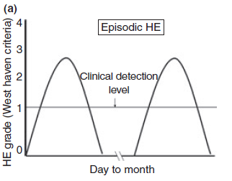
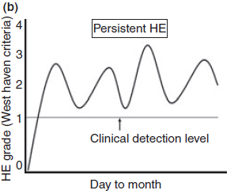
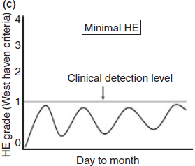
Subcategories HE

Slide 28
Minimal HE (MHE)
A neuropsychiatric disorder of cirrhotic patients
Clinically (neurologically) free of symptoms
Manifest abnormalities in central nervous system function when assessed using:
Psychometric tests
Electrophysiological techniques
Bajaj SJ et al. Aliment Pharmacol Ther. 2010;31, 537–547

Slide 29
Classification of HE
Differentiation between minimal HE and low-grade, overt HE (i.e., WH I) can be clinically difficult
Therefore, a new classification has been proposed by ISHEN
No clinical,
neurophysiological or neuropsychometric changes
Minimal
HE
Grade
I
Grade
II
Grade
III
Grade
IV
Worsening cognitive function
Unimpaired
Covert HE
Overt HE
Bajaj JS, et al. Aliment Pharmacol Ther. 2011;33:739–47

Slide 30
Burden of HE
45 - 80% of patients with cirrhosis may suffer from minimal HE
Overt HE occurs in 30–45% of patients
HE is a criterion for decompensation
HE is associated with poor prognosis
1-year mortality in patients with an HE diagnosis was 64% (5-year mortality 85%)
Ortiz M, et al. J Hepatol. 2005;42(Suppl 1):S45–53
Bass NM. Aliment Pharmacol Ther. 2007;25(Suppl 1):23–31
Poordad FF. Aliment Pharmacol Ther. 2007;25(Suppl 1):3–9
Jepsen P, et al. Hepatology. 2010;51:1675–82
Bajaj JS, et al. Am J Gastroenterol. 2011;106:1646–53

Slide 31
Common precipitating factor for HE
50-80% of patients with episodic HE have an identifiable precipitant
Hypovolaemia/
diuretics
 Hypokalaemia and alkalosis facilitates ammonia production
Dehydration may precipitate worsening mental function in previously controlled HE
Renal failure
 Reduced clearance of ammonia, acid-base imbalance and other nitrogenous products
Upper
GI bleed
 Blood in GI tract leads to increased ammonia and nitrogen absorption
 Tissue catabolism
 Impaired renal function
 Inflammation
Infection
increased blood ammonia
Constipation
 Increases ammonia
Psychoactive
medication
 Worsen symptoms of HE
 HE is the most common complication of TIPS
 Related to portal hypoperfusion and increased availability of ammonia and
toxins
 Contributes to astrocyte swelling
TIPS
Hyponatraemia
Additional liver
injury
 Worsens hepatic function and reduces ammonia metabolism
Morgan MY. In Sherlock's Disease of the Liver and Biliary System, 12th ed: Blackwell Publishing Ltd; 2011
Bajaj JS. Aliment Pharmacol Ther. 2010;31:537–47

Slide 32
Diagnosis
Overt HE is a clinical diagnosis; signs and symptoms include:
Minimal HE requires psychometric testing to identify and diagnose
Personality changes
Sleep disturbances
Confusion
Depression
Slurred speech
Lethargy
Coma
Asterixis
Ataxia
Foetor hepaticus;
Sweet or musty odour of breath
and urine believed to be due to mercaptans
Bass NM. Aliment Pharmacol Ther. 2007;25(Suppl 1):23–31
Harrison, Internal Medicine. 15th Ed:p1765
Ferenci P, et al. Hepatology. 2002;35:716–21

Slide 33
Clinical evaluation
HE should only be diagnosed after the exclusion of other potential causes
Previously unknown focal deficits point towards alternatives such as SDH or Ischemic event
Evaluation should include vital signs and air way protection
The physical examination should also concentrate on grading the severity - WHC

Slide 34



Diagnostic tools
Tools for detecting HE
Psychometric
testing
Neurophysiologic
testing
Neuroimaging
Blood ammonia
levels
Neuro-psychological
assessments
EEG
(Specialised analysis may be necessary)
CT scan
(for exclusion of other causes)
Helpful in
evaluation and for planning management
Computerised Tests
(e.g. Vienna Determination
Test, Vienna Reaction Test)
MRI
Critical Flicker
MRS
(mainly for research)
Paper and Pencil
Tests
(e.g. Number Connection Test, Serial Dotting Test, Line Tracing Test)
Evoked potentials
Inhibitory control test
PET scan
(research tool)
Bajaj JS. Expert Rev Gastroenterol Hepatol. 2008;2:785–90
Blei AT, et al. Am J Gastroenterol. 2001;96:1968–76
Morgan MY. In Sherlock's Disease of the Liver and Biliary System, 12th ed: Blackwell Publishing Ltd; 2011

Slide 35
Suggested treatment algorithm for overt HE
Patient with possible overt HE
Not HE: Alternative cause for mental status identified
HE confirmed
Precipitating factor?
Precipitating factor found
Precipitating factor not found
Direct treatment at precipitating factor
Consider: MARS, Embolisation of spontaneous portosystemic shunts, (provided radiologically diagnosed and MELD ± 11) Liver transplant
Admit to ICU for grade ≥3 HE Specific therapy with lactulose (enema if grade ≥ 3)
rifaximin/metranidazole
Failure
Strategies to prevent relapse
 Lactulose
 Rifaximin
Bajaj JS, Aliment Pharmacol Ther. 2010;31:537–47
Häussinger D. Acta Gastro-Enterologica Belgica. 2010;73:457–64
Saliba F. Crit Care. 2006;10:118

Slide 36
Management of HE
Patients with Grade 2 HE should be admitted to identify precipitating factors
Patients with Grade 3 or more HE should be managed in an ICU/HDU
Complete infectious work-up
Diagnostic paracentesis
Pan-culturing of urine and blood
Chest X-ray
Skin examination for possible cellulitis
Bajaj SJ et al. Aliment Pharmacol Ther. 2010;31, 537–547

Slide 37
Management of HE
No role for prophylactic antibiotics in OHE
Unless there is evidence of GI bleeding or sepsis
Metabolic abnormalities should be corrected
Hydration should be gentle, with care not to cause pulmonary congestion
Correction of the underlying factors that precipitate HE might in itself help to resolve HE
Bajaj SJ et al. Aliment Pharmacol Ther. 2010;31, 537–547

Slide 38
Specific treatment interventions in HE
Reduction in Ammonia production
Lactulose, Rifaximin, Metronidazole
Alternative pathways for ammonia disposal
L-Ornithine L- Aspartate (LOLA)
Modifying porto-systemic collaterals
persistent HE not responding to therapy, HE after TIPS
Nutritional Interventions
Branched chain amino acids and vegetable based proteins
Zn supplementation may provide a benefit in HE

Slide 39
Resistant HE
If HE persists after 72 h of treatment, the following possibilities must be explored:
Other causes of encephalopathy might have been missed or inadequately treated
A precipitating factor might have been missed, treated inadequately
Effective empiric therapy has not been instituted
Keep on searching for missed possibilities
shunts?, occult infections ?, benzodiacepines?

Slide 40
Lactulose for secondary prophylasix (ITT)
Patients recovering from HE; existing therapy continued; randomised to lactulose or placebo
Mean MELD score 21.8 and 20.6 respectively at baseline; median 14 months’ follow-up
Breakthrough HE (%)
50
47
*
20
20
0
Lactulose
(n=61)
Placebo
(n=64)
*p=0.001
Sharma BC, et al. Gastroenterology. 2009;137:885–91

Slide 41
Lactulose tolerability
Patients taking lactulose require education regarding AE
Dose should be carefully titrated to maintain 2–3 stools/day without diarrhoea
In patients with acute liver failure caution due to risk of colonic distension, particularly if surgery planned
Excessive sweet taste
Flatulence and bloating
Electrolyte imbalance
Hypernatraemia which can deteriorate patient’s mental condition
Abdominal cramping
Diarrhoea
May worsen HE and risk of hypovolaemia and hyponatraemia
Al Sibae MR, McGuire BM. Ther Clin Risk Manag. 2009;5:617–26
Garcia-Tsao G, et al. Am J Gastroenterol. 2009;104:1802–29
McDowell Torres D, et al. Gastroenterol Hepatol (NY) 2010;6:444-50

Slide 42
Rifaximin for secondary prophylaxis of HE: Recurrence
91% of study patients were receiving lactulose
58% risk reduction (NNT=4 over 6 months)
Recurrent HE (patients, %)
Free from HE recurrence (patients, %)
50
46
100
22
80
60
40
Rifaximin 550 mg bid (n=140)
Placebo (n=159)
20
Hazard ratio: 0.42 (95% CI, 0.28–0.64)
p<0.001
0
Rifaximin
550 mg bid
(n=140)
Placebo
(n=159)
0
0
28
56
84
112
140
168
Days since randomisation
Bass NM et al. N Engl J Med. 2010; 362:1071-78

Slide 43
Rifaximin for secondary prophylaxis of HE: Hospitalisation
Hospitalisation
(patients,
%)
Not hospitalised
(patients, %)
50
100
80
60
23
14
40
Rifaximin 550 mg bid (n=140)
Placebo (n=159)
20
Hazard ratio: 0.50 (95% CI, 0.29–0.87)
p=0.01
0
0
Rifaximin
550 mg bid
(n=140)
Placebo
(n=159)
0
28
56
84
112
140
168
Days since randomisation
50% risk reduction (NNT=9 over 6 months)
Bass NM et al. N Engl J Med. 2010; 362:1071-78

Slide 44
Nutritional advice in patients with cirrhosis
Maintain protein intake 1.2-1.5 g/kg
Protein restricted diet seldom have place in management or prevention of HE
Vegetable or casein protein may be better tolerated
Frequent meals (6 or more a day)
Complex (not simple) CHO
Nocturnal feeding
Balanced diet of 30 kcal/kg body weight
Corrected or ideal body weight in patient with ascites
30-35% of calories consumed as fat
30-55% of calories consumed as CHO
Chadalavada R, et al. Nutr Clin Pract. 2010;25:257–64
Verslype C, Cassiman D. Acta Gastroenterol Belg. 2010;73:510–3

Slide 45
HE: General considerations
HE is common in patients with cirrhosis
Therefore testing for HE should be part of routine evaluation of cirrhotic patients
Early identification of lower grade of HE allows intervention to be initiated
Reduce risk of developing more severe grade HE
May potentially avoid longer term cognitive deficit
Options for treatment include lactulose, rifaximin, metronidazole

Slide 46
HE: General considerations
Rifaximin in addition to lactulose prevent recurrence
Patient follow up is important
Ensure on-going compliance with therapy
Patient and family/care giver education
HE is a decompensation event with poor prognosis
Consider evaluation for transplant

Slide 47
3. HCC

Slide 48
Objectives
Screening for HCC
Accurate diagnosis
Assessment of prognosis
– Staging of the disease
Selection of the most effective treatment
Curative, Palliative, Supportive

Slide 49
Case study
49 year old female patient with ‘cryptogenic’ cirrhosis is attending clinic for routine follow up
Decompensation with icterus and pedal oedema
CTP B8; MELD 11
Past history of cirrhotic complications – HE x 1, SBP x 1
Last UGIE 3 months - Small varices
Last screening 10 months ago – No HCC

Slide 50
Q1. How and when should screening for HCC carried out?
1. AFP every 6 months
2. US scan ever 6 months
3. AFP and US scan every 6 months
4. AFP every 12 months
5. AFP and US scan every 12 months

Slide 51
Why screen for HCC?
At-risk population can be identified on the basis of the presence of chronic viral hepatitis B and or cirrhosis
Surveillance reduces patient mortality because of the increased applicability of curative measures to HCC-detected patients

Slide 52
Who should be screened for HCC?
Surveillance recommended in at-risk groups
Specific hepatitis B carrier
Asian males HBV carriers older than 40 years of age
Asian female HBV carriers older than 50 years of age
HBV carrier with HCC family history
African/N American blacks with HBV
Cirrhotic HBV carriers
Non–hepatitis B cirrhosis
80% of patients with HCC have underlying cirrhosis
Bruix J, et al. AASLD HCC guidelines. July 2010.
Simonetti RS, et al. Dig Dis Sci. 1991;36:962-972.

Slide 53
How to screen for HCC?
HCC surveillance should be performed with ultrasound
Patients should be screened at 6-month intervals (biannual)
Increased surveillance interval in patients at higher risk not needed
Bruix J, et al. AASLD HCC guidelines. July 2010.

Slide 54
How to not screen for HCC?
HCC surveillance should not be performed with alpha feto protein (AFP)
The diagnostic sensitivity of AFP is only ~ 60%
As a surveillance tool is worse still
AFP levels often fluctuate (false positives)
Only 10% - 20% of early tumours have abnormal AFP levels (false negatives)
Combining AFP with US increases costs but improves detection by only 6% to 8%

Slide 55
Q1. How and when should screening for HCC carried out?
1. AFP every 6 months
2. US scan every 6 months
3. AFP and US scan every 6 months
4. AFP every 12 months
5. AFP and US scan every 12 months

Slide 56

Q1. How and when should screening for HCC carried out?
1. AFP every 6 months
2. US scan every 6 months
3. AFP and US scan every 6 months
4. AFP every 12 months
5. AFP and US scan every 12 months

Slide 57
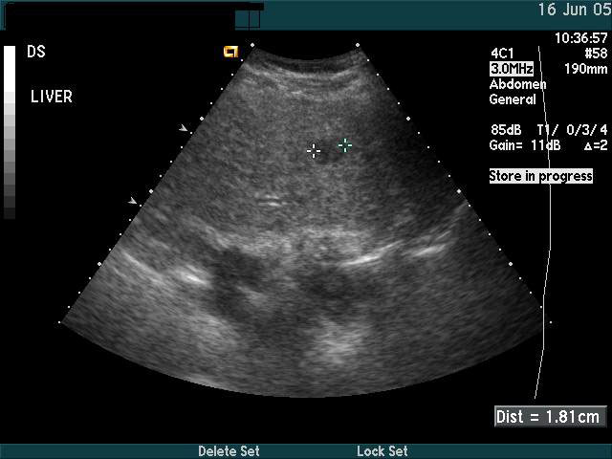
Case study cont.
Repeat US scan reveals a 0.8 cm nodule in segment V

Slide 58
Case study cont.
Repeat US scan reveals a 0.8 cm nodule in segment V

Slide 59
Q2. What is the next step?
1. AFP
2. Biopsy
3. CE CT abdomen (4 phase)
4. Dynamic MRI
5. Repeat US scan in 3 months

Slide 60
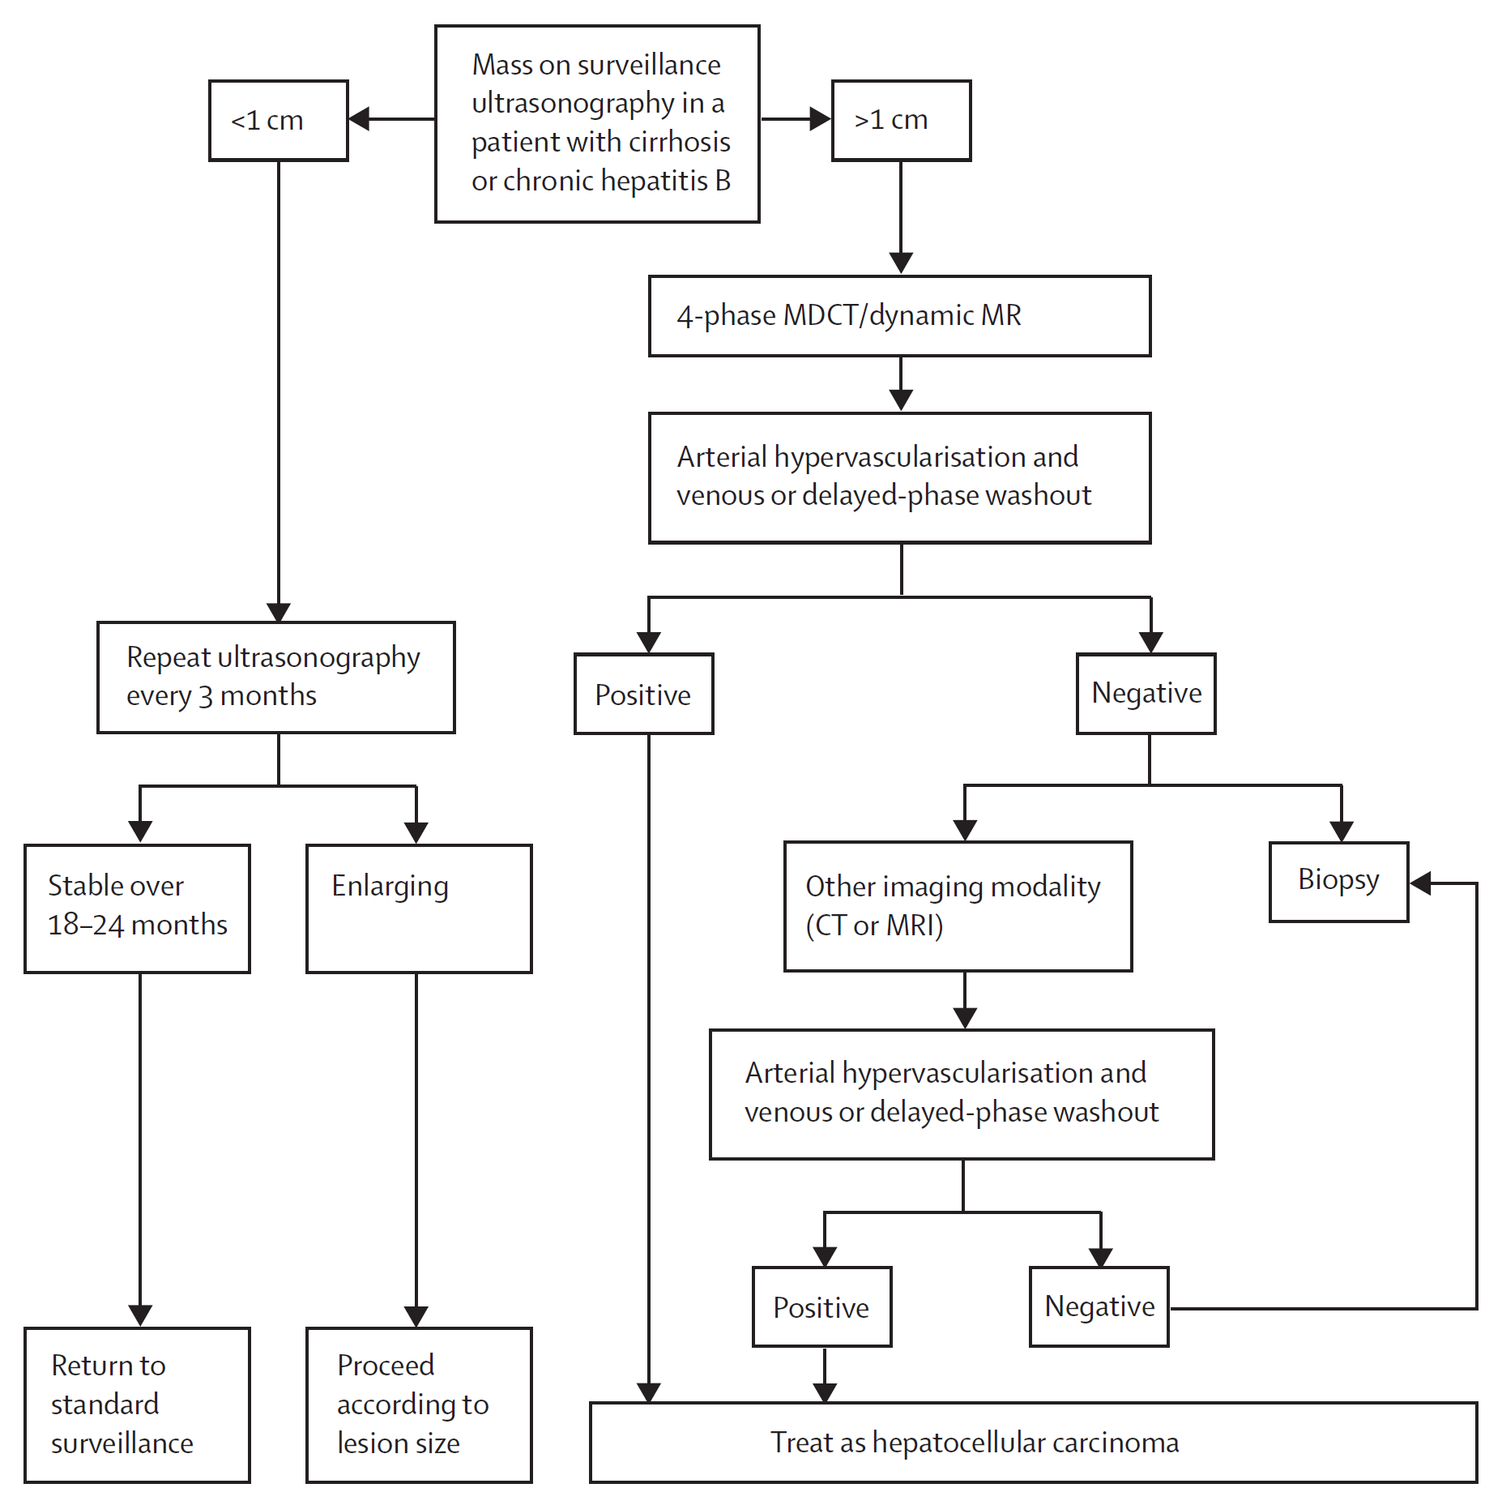
What to do when screening is positive?

Slide 61
What to do when screening is positive?

Slide 62
Q2. What is the next step?
1. AFP
2. Biopsy
3. CE CT abdomen (4 phase)
4. Dynamic MRI
5. Repeat US scan in 3 months

Slide 63
Q2. What is the next step?
1. AFP
2. Biopsy
3. CE CT abdomen (4 phase)
4. Dynamic MRI
5. Repeat US scan in 3 months

Slide 64
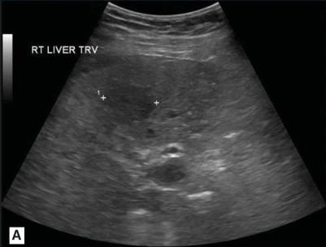
Case study cont.
Repeat US scan in 3 months reveals an enlarged 2.8 cm nodule in segment V

Slide 65
Q3. What is the next step?
1. AFP
2. Biopsy
3. CE CT abdomen (4 phase)
4. Dynamic contrast MRI
5. Repeat US scan in 3 months

Slide 66
What to do when screening is positive?

Slide 67
What to do when screening is positive?

Slide 68
Q3. What is the next step?
1. AFP
2. Biopsy
3. CE CT abdomen (4 phase)
4. Dynamic contrast MRI
5. Repeat US scan in 3 months

Slide 69
Q3. What is the next step?
1. AFP
2. Biopsy
3. CE CT abdomen (4 phase)
4. Dynamic contrast MRI
5. Repeat US scan in 3 months

Slide 70
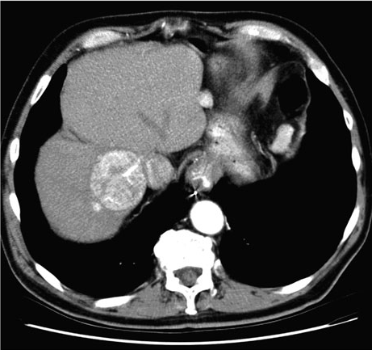
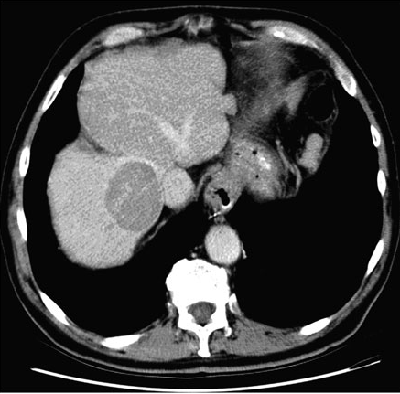
Case study - CE CT Abdomen
Arterial phase (30 sec) Portal venous phase (70 sec)

Slide 71
Q4. What is the stage of HCC in this patient?
1. Very early stage
2. Early stage
3. Intermediate stage
4. Advanced stage
5. Terminal stage

Slide 72
How to stage HCC?
Assessing prognosis should account for
main prognostic variables
Tumour status
Number, Size, Vascular invasion, Extra-hepatic spread
Degree of liver function impairment
Child-Pugh scoring system
Presence of cancer-related symptoms
Performance status
Should predict outcome and assign treatment

Slide 73
BCLC strategy
BCLC (Barcelona Clinic Liver Cancer) classification
Only system that links cancer stage with prognosis and treatment
Validated in different setting, in prospective studies
de facto staging system
Recommended for prognostic prediction and treatment allocation by
AASLD guideline on HCC – 2011 update
EASL guideline on HCC - 2012

Slide 74
BCLC Staging System
HCC
Stage 0
Stage A-C
Stage D
PS 0, Child-Pugh A
PS 0-2, Child-Pugh A-B
PS > 2, Child-Pugh C
Very early stage (0)
Early stage (A)
Intermediate stage (B)
Advanced stage (C)
Terminal stage (D)
Single < 2 cm
Carcinoma in situ
Single or 3 nodules
Portal invasion,
< 3 cm, PS 0
Multinodular, PS 0
N1, M1, PS 1-2
Llovet JM, et al. Design and endpoints of clinical trials in hepatocellular carcinoma. Journal of the National Cancer Institute. 2008;100(10):698-711
Notes:
74
BCLC, Barcelona Clinic Liver Cancer; HCC, hepatocellular carcinoma; PST, performance status.
Josep M. Llovet, MD:
The Barcelona system differentiates 5 stages of HCC disease. Stage 0 cases are chronic patients with small lesions, < 2 cm in size, with single tumors, and no evidence of vascular invasion or extrahepatic spread. These should be asymptomatic, Child-Pugh A class patients. Early-stage patients have a single tumor or 3 nodules < 3 cm according to the Milan criteria, and an ECOG performance score of 0, whereas intermediate-, advanced-, and terminal-stage patients have multinodular or disseminated disease.

Slide 75
BCLC Staging System
HCC
Stage 0
Stage A-C
Stage D
PS 0, Child-Pugh A
PS 0-2, Child-Pugh A-B
PS > 2, Child-Pugh C
Very early stage (0)
Early stage (A)
Intermediate stage (B)
Advanced stage (C)
Terminal stage (D)
Single < 2 cm
Carcinoma in situ
Single or 3 nodules
Portal invasion,
< 3 cm, PS 0
Multinodular, PS 0
N1, M1, PS 1-2
Well preserved Liver function
Small asymtomatic
nodule without vascular invasion or satellites
Excellent outcome
Llovet JM, et al. Design and endpoints of clinical trials in hepatocellular carcinoma. Journal of the National Cancer Institute. 2008;100(10):698-711
Notes:
75
BCLC, Barcelona Clinic Liver Cancer; HCC, hepatocellular carcinoma; PST, performance status.
Josep M. Llovet, MD:
The Barcelona system differentiates 5 stages of HCC disease. Stage 0 cases are chronic patients with small lesions, < 2 cm in size, with single tumors, and no evidence of vascular invasion or extrahepatic spread. These should be asymptomatic, Child-Pugh A class patients. Early-stage patients have a single tumor or 3 nodules < 3 cm according to the Milan criteria, and an ECOG performance score of 0, whereas intermediate-, advanced-, and terminal-stage patients have multinodular or disseminated disease.

Slide 76
BCLC Staging System
HCC
Stage 0
Stage A-C
Stage D
PS 0, Child-Pugh A
PS 0-2, Child-Pugh A-B
PS > 2, Child-Pugh C
Very early stage (0)
Early stage (A)
Intermediate stage (B)
Advanced stage (C)
Terminal stage (D)
Single < 2 cm
Carcinoma in situ
Single or 3 nodules
Portal invasion,
< 3 cm, PS 0
Multinodular, PS 0
N1, M1, PS 1-2
End-stage patient
Deranged liver function
Completely disabled
Poor prognosis
No intervention will benefit
Llovet JM, et al. Design and endpoints of clinical trials in hepatocellular carcinoma. Journal of the National Cancer Institute. 2008;100(10):698-711
Notes:
76
BCLC, Barcelona Clinic Liver Cancer; HCC, hepatocellular carcinoma; PST, performance status.
Josep M. Llovet, MD:
The Barcelona system differentiates 5 stages of HCC disease. Stage 0 cases are chronic patients with small lesions, < 2 cm in size, with single tumors, and no evidence of vascular invasion or extrahepatic spread. These should be asymptomatic, Child-Pugh A class patients. Early-stage patients have a single tumor or 3 nodules < 3 cm according to the Milan criteria, and an ECOG performance score of 0, whereas intermediate-, advanced-, and terminal-stage patients have multinodular or disseminated disease.

Slide 77
BCLC Staging System
HCC
Stage 0
Stage A-C
Stage D
PS 0, Child-Pugh A
PS 0-2, Child-Pugh A-B
PS > 2, Child-Pugh C
Very early stage (0)
Early stage (A)
Intermediate stage (B)
Advanced stage (C)
Terminal stage (D)
Single < 2 cm
Carcinoma in situ
Single or 3 nodules
Portal invasion,
< 3 cm, PS 0
Multinodular, PS 0
N1, M1, PS 1-2
Liver Function – Child-Pugh A-B
Performance Status – Asymtomatic (0) to cancer related symptoms (1,2)
Tumour burden – liver-only disease to metastatic disease
Clinical profile heterogeneous
Llovet JM, et al. Design and endpoints of clinical trials in hepatocellular carcinoma. Journal of the National Cancer Institute. 2008;100(10):698-711
Notes:
77
BCLC, Barcelona Clinic Liver Cancer; HCC, hepatocellular carcinoma; PST, performance status.
Josep M. Llovet, MD:
The Barcelona system differentiates 5 stages of HCC disease. Stage 0 cases are chronic patients with small lesions, < 2 cm in size, with single tumors, and no evidence of vascular invasion or extrahepatic spread. These should be asymptomatic, Child-Pugh A class patients. Early-stage patients have a single tumor or 3 nodules < 3 cm according to the Milan criteria, and an ECOG performance score of 0, whereas intermediate-, advanced-, and terminal-stage patients have multinodular or disseminated disease.

Slide 78
Case study cont.
Single nodule < 3cm
CTP class B
Performance status (PS) – 0
Small varices +
Icterus - S bilirubin 2.2 mg/dl

Slide 79
Q4. What is the stage of HCC in this patient?
1. Very early stage
2. Early stage
3. Intermediate stage
4. Advanced stage
5. Terminal stage

Slide 80
Q4. What is the stage of HCC in this patient?
1. Very early stage
2. Early stage
3. Intermediate stage
4. Advanced stage
5. Terminal stage

Slide 81
Q5. What is the best treatment option for this patient’s HCC?
1. Resection
2. Liver transplantation
3. Ablation
4. TACE
5. Sorafenib

Slide 82
How to treat HCC ?
Surgical
Surgical Resection
Liver transplantation
Liver directed (image guided) therapies
Percutaneous ablation – RFA (Radio-Frequency Ablation), PEI (Percutaneous Ethanol Injection)
Trans-catheter embolisation – TACE (Trans-Arterial Chemo-Embolisation)
Systemic therapies
Sorafenib

Slide 83
How to treat HCC ?
Surgical
Surgical Resection
Liver transplantation
Liver directed (image guided) therapies
Ablation – RFA (Radio-Frequency Ablation), PEI (Percutaneous Ethanol Injection)
Embolisation – TACE (Trans-Arterial Chemo-Embolisation)
Systemic therapies
Sorafenib
High rate of Complete Response; potentially curative

Slide 84
How to treat HCC ?
Surgical
Surgical Resection
Liver transplantation
Liver directed (image guided) therapies
Ablation – RFA (Radio-Frequency Ablation), PEI (Percutaneous Ethanol Injection)
Embolisation – TACE (Trans-Arterial Chemo-Embolisation)
Systemic therapies
Sorafenib
Non-curative; Improves survival

Slide 85
Management of HCC requires a Multidisciplinary Team (MDT) approach
Hepatobilliary Surgery
Hepatology
Complexity of HCC
Many potential treatment options
Level of evidence for Rx options restricted
Oncology
Pathology
Radiology
Liver Transplant Program
Notes:
85
Slide 264
Management of Hepatocellular Carcinoma Requires a Multidisciplinary Approach

Slide 86
BCLC Staging and Treatment Strategy
HCC
PS 0, Child-Pugh A
Okuda 1-2, PS 0-2, Child-Pugh A-B
Okuda 3, PS > 2, Child-Pugh C
Very early stage (0)
Early stage (A)
Intermediate stage (B)
Advanced stage (C)
Terminal stage (D)
Single < 2 cm
Carcinoma in situ
Single or 3 nodules
Portal invasion,
< 3 cm, PS 0
Multinodular, PS 0
N1, M1, PS 1-2
Single
3 nodules ≤ 3 cm
Portal pressure/bilirubin
Increased
Associated
diseases
Normal
No
Yes
Resection
Liver transplantation
RFA/PEI
TACE
Sorafenib
Symptomatic (20%);
survival < 3 mos
Curative treatments (30%); 5-yr survival: 40%-70%
RCTs (50%); 3-yr survival: 10%-40%
Llovet JM, et al. Design and endpoints of clinical trials in hepatocellular carcinoma. Journal of the National Cancer Institute. 2008;100(10):698-711.
Notes:
86
BCLC, Barcelona Clinic Liver Cancer; HCC, hepatocellular carcinoma; PEI, percutaneous ethanol injection; PS, performance score; RCT, randomized controlled trial; RFA, radiofrequency ablation; TACE, transarterial chemoembolization.
Josep M. Llovet, MD:
With appropriate use of resection, transplantation, and local ablation, 5-year survival rates > 50% can be expected, rising to 70% with resection and liver transplantation. However, these treatments are currently considered in approximately 30% of patients in the West and even fewer patients worldwide. For example, in Asia, only 5% to 10% of patients receive potentially curative therapies.
Jorge A. Marrero, MD, MS:
How does one choose between radiofrequency ablation and resection, given that there are data from a randomized trial showing no difference in overall survival between the 2 strategies?
Josep M. Llovet, MD:
If the tumor is < 2 cm in diameter, radiofrequency ablation can achieve a complete response rate of up to 98%, which is comparable with resection. In tumors of this size, the decision of whether to apply radiofrequency ablation rather than resection may depend on local availability of a hepatobiliary team with experience in resecting tumors or, conversely, access to an interventional radiologist able to perform local ablation with high accuracy.
For tumors > 2 cm in diameter, in my experience, local ablation does not achieve a complete response rate of 100%, and as the tumor size increases, the response rate decreases, such that for a tumor of 4-5 cm in diameter, radiofrequency ablation achieves complete response in approximately 50% to 60% of cases. This does not compete well with resection. Therefore, resection remains a first-line treatment option for tumors > 2 cm in diameter. For very small tumors of < 2 cm, there is a question about which approach is optimal, and local expertise should factor in the decision.

Slide 87
BCLC Staging and Treatment Strategy
HCC
PS 0, Child-Pugh A
Okuda 1-2, PS 0-2, Child-Pugh A-B
Okuda 3, PS > 2, Child-Pugh C
Very early stage (0)
Early stage (A)
Intermediate stage (B)
Advanced stage (C)
Terminal stage (D)
Single < 2 cm
Carcinoma in situ
Single or 3 nodules
Portal invasion,
< 3 cm, PS 0
Multinodular, PS 0
N1, M1, PS 1-2
Potentially Curable HCC
Single
3 nodules ≤ 3 cm
Portal pressure/bilirubin
Increased
Associated
diseases
Normal
No
Yes
Resection
Liver transplantation
RFA/PEI
TACE
Sorafenib
Symptomatic (20%);
survival < 3 mos
Curative treatments (30%); 5-yr survival: 40%-70%
RCTs (50%); 3-yr survival: 10%-40%
Llovet JM, et al. Design and endpoints of clinical trials in hepatocellular carcinoma. Journal of the National Cancer Institute. 2008;100(10):698-711.
Notes:
87
BCLC, Barcelona Clinic Liver Cancer; HCC, hepatocellular carcinoma; PEI, percutaneous ethanol injection; PS, performance score; RCT, randomized controlled trial; RFA, radiofrequency ablation; TACE, transarterial chemoembolization.
Josep M. Llovet, MD:
With appropriate use of resection, transplantation, and local ablation, 5-year survival rates > 50% can be expected, rising to 70% with resection and liver transplantation. However, these treatments are currently considered in approximately 30% of patients in the West and even fewer patients worldwide. For example, in Asia, only 5% to 10% of patients receive potentially curative therapies.
Jorge A. Marrero, MD, MS:
How does one choose between radiofrequency ablation and resection, given that there are data from a randomized trial showing no difference in overall survival between the 2 strategies?
Josep M. Llovet, MD:
If the tumor is < 2 cm in diameter, radiofrequency ablation can achieve a complete response rate of up to 98%, which is comparable with resection. In tumors of this size, the decision of whether to apply radiofrequency ablation rather than resection may depend on local availability of a hepatobiliary team with experience in resecting tumors or, conversely, access to an interventional radiologist able to perform local ablation with high accuracy.
For tumors > 2 cm in diameter, in my experience, local ablation does not achieve a complete response rate of 100%, and as the tumor size increases, the response rate decreases, such that for a tumor of 4-5 cm in diameter, radiofrequency ablation achieves complete response in approximately 50% to 60% of cases. This does not compete well with resection. Therefore, resection remains a first-line treatment option for tumors > 2 cm in diameter. For very small tumors of < 2 cm, there is a question about which approach is optimal, and local expertise should factor in the decision.

Slide 88
BCLC Staging and Treatment Strategy
HCC
PS 0, Child-Pugh A
Okuda 1-2, PS 0-2, Child-Pugh A-B
Okuda 3, PS > 2, Child-Pugh C
Very early stage (0)
Early stage (A)
Intermediate stage (B)
Advanced stage (C)
Terminal stage (D)
Single < 2 cm
Carcinoma in situ
Single or 3 nodules
Portal invasion,
< 3 cm, PS 0
Multinodular, PS 0
N1, M1, PS 1-2
Single
3 nodules ≤ 3 cm
Uncurable HCC
Portal pressure/bilirubin
Increased
Associated
diseases
Normal
No
Yes
Resection
Liver transplantation
RFA/PEI
TACE
Sorafenib
Symptomatic (20%);
survival < 3 mos
Curative treatments (30%); 5-yr survival: 40%-70%
RCTs (50%); 3-yr survival: 10%-40%
Llovet JM, et al. Design and endpoints of clinical trials in hepatocellular carcinoma. Journal of the National Cancer Institute. 2008;100(10):698-711.
Notes:
88
BCLC, Barcelona Clinic Liver Cancer; HCC, hepatocellular carcinoma; PEI, percutaneous ethanol injection; PS, performance score; RCT, randomized controlled trial; RFA, radiofrequency ablation; TACE, transarterial chemoembolization.
Josep M. Llovet, MD:
With appropriate use of resection, transplantation, and local ablation, 5-year survival rates > 50% can be expected, rising to 70% with resection and liver transplantation. However, these treatments are currently considered in approximately 30% of patients in the West and even fewer patients worldwide. For example, in Asia, only 5% to 10% of patients receive potentially curative therapies.
Jorge A. Marrero, MD, MS:
How does one choose between radiofrequency ablation and resection, given that there are data from a randomized trial showing no difference in overall survival between the 2 strategies?
Josep M. Llovet, MD:
If the tumor is < 2 cm in diameter, radiofrequency ablation can achieve a complete response rate of up to 98%, which is comparable with resection. In tumors of this size, the decision of whether to apply radiofrequency ablation rather than resection may depend on local availability of a hepatobiliary team with experience in resecting tumors or, conversely, access to an interventional radiologist able to perform local ablation with high accuracy.
For tumors > 2 cm in diameter, in my experience, local ablation does not achieve a complete response rate of 100%, and as the tumor size increases, the response rate decreases, such that for a tumor of 4-5 cm in diameter, radiofrequency ablation achieves complete response in approximately 50% to 60% of cases. This does not compete well with resection. Therefore, resection remains a first-line treatment option for tumors > 2 cm in diameter. For very small tumors of < 2 cm, there is a question about which approach is optimal, and local expertise should factor in the decision.

Slide 89
Q5. What is the best treatment option for this patient?
1. Resection
2. Liver transplantation
3. Ablation
4. TACE
5. Sorafenib

Slide 90
Q5. What is the best treatment option for this patient?
1. Resection
2. Liver transplantation
3. Ablation
4. TACE
5. Sorafenib

Slide 91
Conclusion
Screening for HCC is with biannual US scans
In cirrhotic liver HCC can be confidently diagnosed on imaging
BCLC strategy preferred staging system
Varying treatment options for varying stage of disease
Needs a ‘MDT’ approach to management
Selection of most appropriate treatment results in better outcomes through effective treatment

Slide 92
4. Ascites

Slide 93
Ascites in cirrhosis
Common complication of cirrhosis with PH
~50% cirrhotics develop ascites within 10y of diagnosis
Associated with poor quality of life, increased risk of infection (SBP), renal failure (HRS), hyponatraemia
Poor long-term outcome

Slide 94
Pathogenesis
Increased hepatic resistance to portal blood flow leads to local production of vasodilators (NO) causing peripheral (splanchnic) vasodilatation
As splanchnic vasodilatation worsens hyperkinetic circulation fails to maintain arterial pressure
Reduced GFR
Activation of renin-angiotensin-aldosterone
Increased sympathetic nerve activity
Increase in arterial pressure, but also avid Na and water retention resulting in ascites

Slide 95
Ascites
As portal hypertension worsens, progressive Na retention, ascites, and renal impairment
Clinical progression through responsive ascites, refractory ascites to hepato-renal syndrome
Increasingly worsening prognosis

Slide 96
Prognosis in cirrhosis
As portal hypertension worsens, progressive Na retention, ascites, and renal impairment
Ascites Average survival
^{Absent > 6 years}
Early (responsive to diuretics) 5 years
^{Refractory 1 year}
Hepato-renal syndrome (type I) < 2 weeks

Slide 97
Classification
Severity
Grade 1 (Mild) – Detected only on USS
Grade 2 (Moderate) – Clinically detectable, non-tense
Grade 3 (Severe) – Tense distension
Complications
Uncomplicated – ascites without infection or HRS
Complicated – ascites with infection or HRS
Response to diuretics
Responsive or - Refractory

Slide 98
Management of ascites
Initial increase in renal Na resorption is mainly in the distal tubule: spironolactone - aldosterone antagonist, distal diuretic - plus salt restriction effective in controlling ascites
As proximal tubule Na resorption increases, loop diuretics (eg. frusemide) required for natriuresis
Proximal tubule Na resorption gradually increases to levels where spironolactone and frusemide not effective in controlling ascites

Slide 99
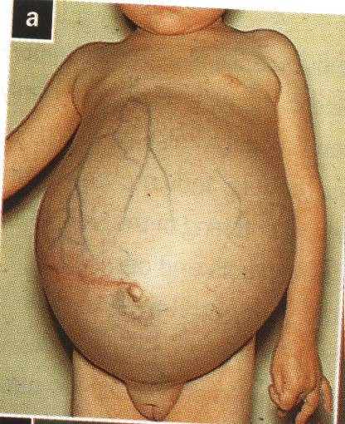

Slide 100
Refractory ascites
2 Types
Diuretic resistant ascites
Diuretic intolerant/intractable ascites
Onset marks sharp worsening in prognosis (50% mortality in 2y; consider liver transplantation if available)

Slide 101
Refractory ascites
Diuretic resistance
Ascites which does not respond (cannot be mobilised or early recurrence – reappearance of Grade 2 or 3 ascites within 4/52) to ‘maximum’ dose diuretics (spironolactone 400mg + frusemide 160mg d) and salt restricted diet of 90 mmol/D (<2g/D) for at least one week
Diuretic intractable
Patients unable to tolerate diuretics for ascites control (HE, Na/K imbalance,uraemia)

Slide 102
Management of refractory ascites
Treatment options
Paracentesis - repeated large volume / total
TIPSS
Liver transplantation: survival benefit

Slide 103
Large volume paracentesis
More effective, less complications than high dose diuretics, and most widely accepted
Combined with plasma volume expanders to prevent circulatory dysfunction (Albumin is superior to dextran 70 & polygeline)
Not required if <4L removed
>5L removed: replace 8g albumin/L fluid removed

Slide 104
Large volume paracentesis
Circulatory dysfunction with plasma volume depletion associated with
High rate of ascites recurrence
Increased renin activity, insidious rise in serum creatinine and onset of HRS type II
Dilutional hyponatraemia
Early recurrences common and does not improve survival (compared with diuretics)

Slide 105
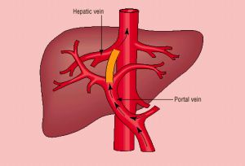
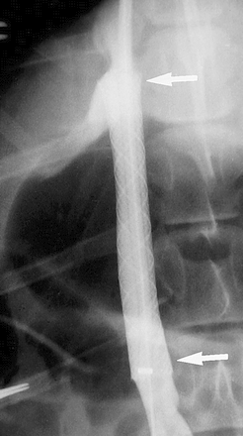
Transjugular Intrahepatic Portosystemic Shunts - TIPSS

Slide 106
TIPSS
Reduces PH by acute shunting of blood into systemic circulation
plasma volume repletion
improved GFR
fall in renin-angiotensin-aldosterone
rise in urine Na excretion

Slide 107
TIPSS
Lowers rate of ascites recurrence and risk of HRS, may allow reduction of diuretics
Eliminates need for liver transplantation for refractory ascites in 50% patients
Complications: hepatic encephalopathy (20%), shunt stenosis (75% at 12m) & migration, biliary puncture, sepsis, DIC
No survival benefit and increased frequency of encephalopathy Vs. large volume paracentesis

Slide 108
TIPSS
Reserved for refractory ascites patients
Without severe liver failure / encephalopathy
Loculated ascites: paracentesis inappropriate
Refuse repeated paracentesis
With variceal bleeding / hypersplenism in addition

Slide 109
Complications of ascites
Spontaneous bacterial peritonitis
Hepatorenal syndrome
Hyponatraemia
All three worsen prognosis

Slide 110
Spontaneous bacterial peritonitis
10-15% of cirrhotic patients develop SBP
Most common infection in cirrhotics
Generally diagnosed on routine analysis of ascitic fluid
Symptoms uncommon - fever, abdominal pain, hepatic encephalopathy
Ascites fluid cell counts
- total > 500 / mm³
- neutrophils >250 / mm³

Slide 111
Antibiotic therapy in SBP
Convincing signs and symptoms of infection
Ascitic fluid neutrophil count > 250 per mm³
Third generation cephalosporins drugs of choice
Longterm prophylaxis with low dose quinolones

Slide 112
Albumin therapy in SBP
Intravenous Albumin (20% salt free)
Albumin 1.5 g/kg/D on D0
Albumin 1.0 g/kg/D on D3
Reduces HRS
Reduces mortality

Slide 113
Hepato-renal syndrome
Renal failure of haemodynamic origin resulting from extreme underfilling of the arterial circulation (severe vasodilatation)
Vasoconstriction of the renal circulation
Occurs in 10% of patients with advanced cirrhosis and ascites
Not the most common cause of renal impairment in cirrhotics

Slide 114
Hepato-renal syndrome
Diagnosis
Cirrhosis with ascites
S Cr > 1.5 mg/dL (>133 µmol/L)
No improvement of S Cr after at lease two days of diuretic withdrawal and volume expansion (albumin 1g/kg/D up to 100g/D)
Absence of shock, No current or recent nephrotoxic drugs
Absence of paranchymal kidney disease
Protienuria < 500 mg/D, microhaematuria < 50 RBC/HPF, normal renal USS

Slide 115
Hepato-renal syndrome
Prognosis is poor, especially in type I (median survival <2w without therapy)
Indication for liver transplantation

Slide 116
Hepato-renal syndrome
Two types:
HRS Type I: rapid onset (days) with progressive oliguria, precipitated by sepsis esp. SBP, UGI bleed, cholestatic jaundice
HRS Type II: insidious onset renal failure (several months), esp. pts. undergoing aggressive diuretic therapy or paracentesis, without adequate volume replacement

Slide 117
HRS – initial treatment
Fluid challenge 1.5 L, Treat infection, review and stop nephrotoxic drugs
Optimise BP - Terlipressin + albumin may achieve prolonged response (several months)
TIPSS reverse HRS; overall 2y survival of 35% (20% HRS I, 70% HRS II)
May delay the need for transplantation
MARS, dopamine, prostaglandins, octreotide, haemodialysis – do not improve outcome

Slide 118
Hypontraemia
Occurs in 30% of cirrhotics: severe hyponatraemia is uncommon (Na+ < 125mEq/L 5.7% , <110 mEq/L 1.2%)
Always associated with ascites; not associated with age, sex or aetiology of cirrhosis
Independent risk factor for mortality, associated with increased HE, SBP, refractory ascites, HRS
Now inco-operated in to survival prediction models MELD-Na (UKELD) scores
Mainly dilutional due to impaired renal free water clearance

Slide 119
Pathophysiology
Reduced distal delivery
of glomerular filtrate
due to reduced GFR
Increased non-osmotic
release of VP due to
arterial vasodilatation
Impaired
water excretion
Reduced renal PG
due to inhibition
of cyclooxygenase
in cirrhosis
Reduced catabolism
of VP
Dilutional hyponatraemia

Slide 120
Management of hyponatraemia
Current treatment for hyponatraemia suboptimal in most of the cases
Fluid restriction (1000 ml / 24 hrs)
Low sodium diet (6g / 24 hrs)
Minimize the use of diuretics
Avoid hypertonic saline and salt supplementation

Slide 121
Refractory hyponatraemia
Very poor prognosis, and indication for liver transplantation
Trials of aquaretic drugs which induce solutes free water diuresis (V2RA - tolvaptan)
Tolvaptan
short term normalization of serum sodium in up to 50% patients
long term efficacy and safety need further evaluation

Slide 122
Summary
Prognosis of refractory ascites poor and large volume paracentesis most widely used method to control ascites
Development of SBP, HRS and hyponatraemia worsens prognosis further
Terlipressin and TIPSS effective in improving short term survival in HRS
Only liver transplantation definitely improves longterm survival

